Slide 1
DSI - Project 1
Analysis on SAT vs ACT 2017 & 2018
Shaun Kwek

Slide 2
Problem Statement
How to increase the participation rate of SAT for states with low participation rate?

Slide 3
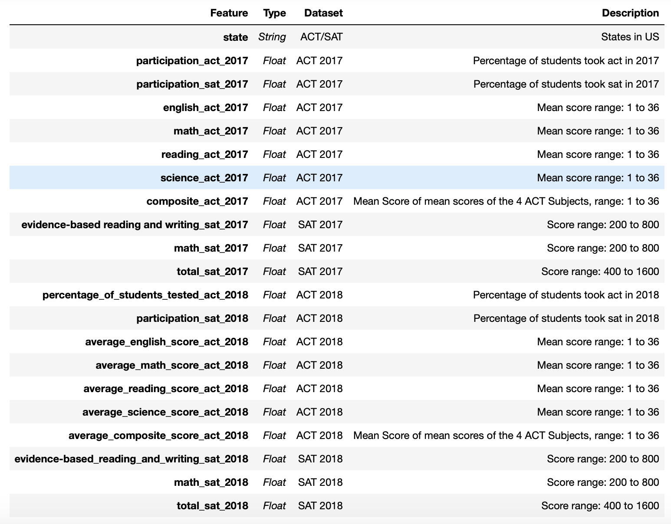
Data Set

Slide 4
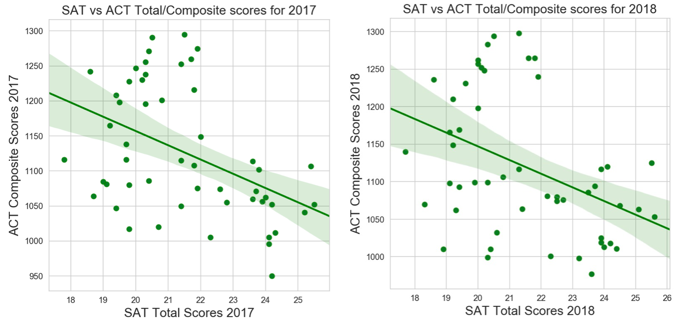
SAT & ACT Score
State’s Mandatory requirements: - 10 states for SAT & 11 states for ACT
States with no mandatory requirement in US
Range of scores for SAT & ACT are different, unable to perform a fair comparison
Pros and cons of both tests.

Slide 5
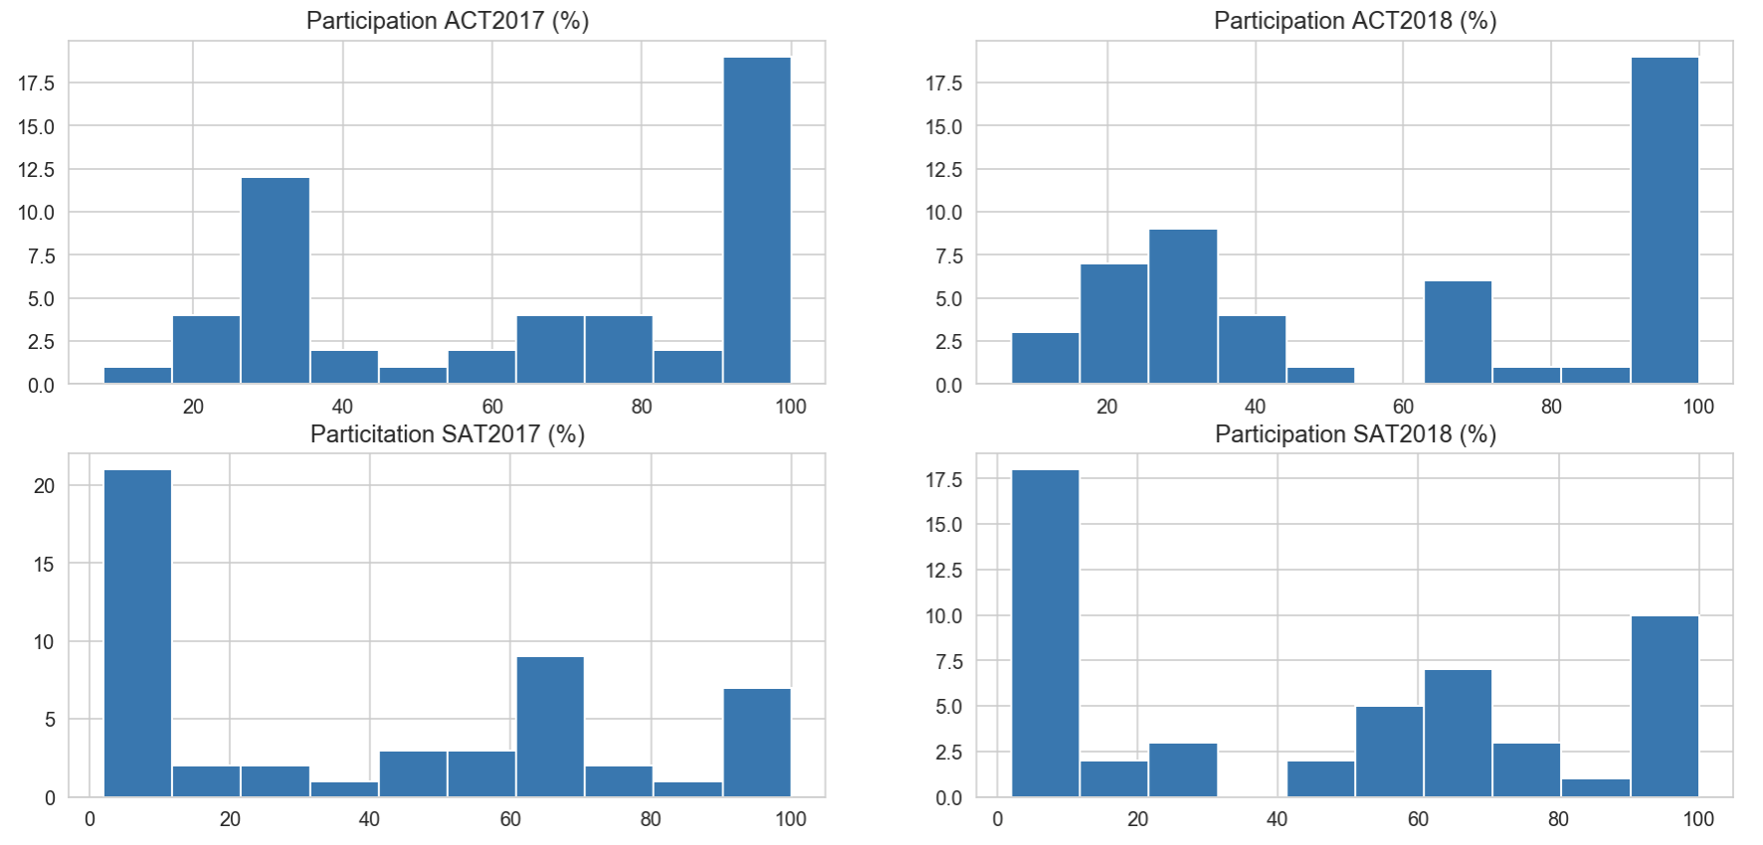
Analysis on participation rate
Increase in participation % in SAT from 2017 to 2018
Decrease in participation % in ACT from 2017 to 2018

Slide 6
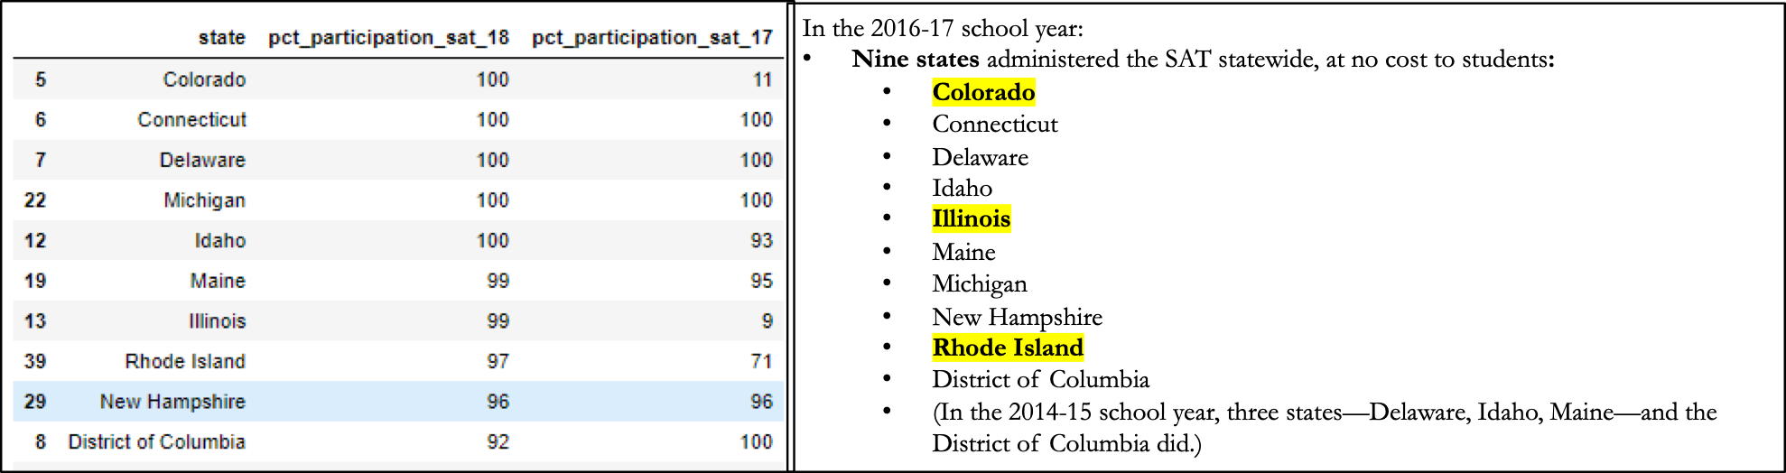
Possible reason for the increase in SAT participation rate
Drastic increase in participation % with the highlighted states after the new initiative (SAT statewide) has been implemented
Colorado: from 11% - 100% Illinois: from 9% to 100% Rhode: Island from 71% to 97%

Slide 7
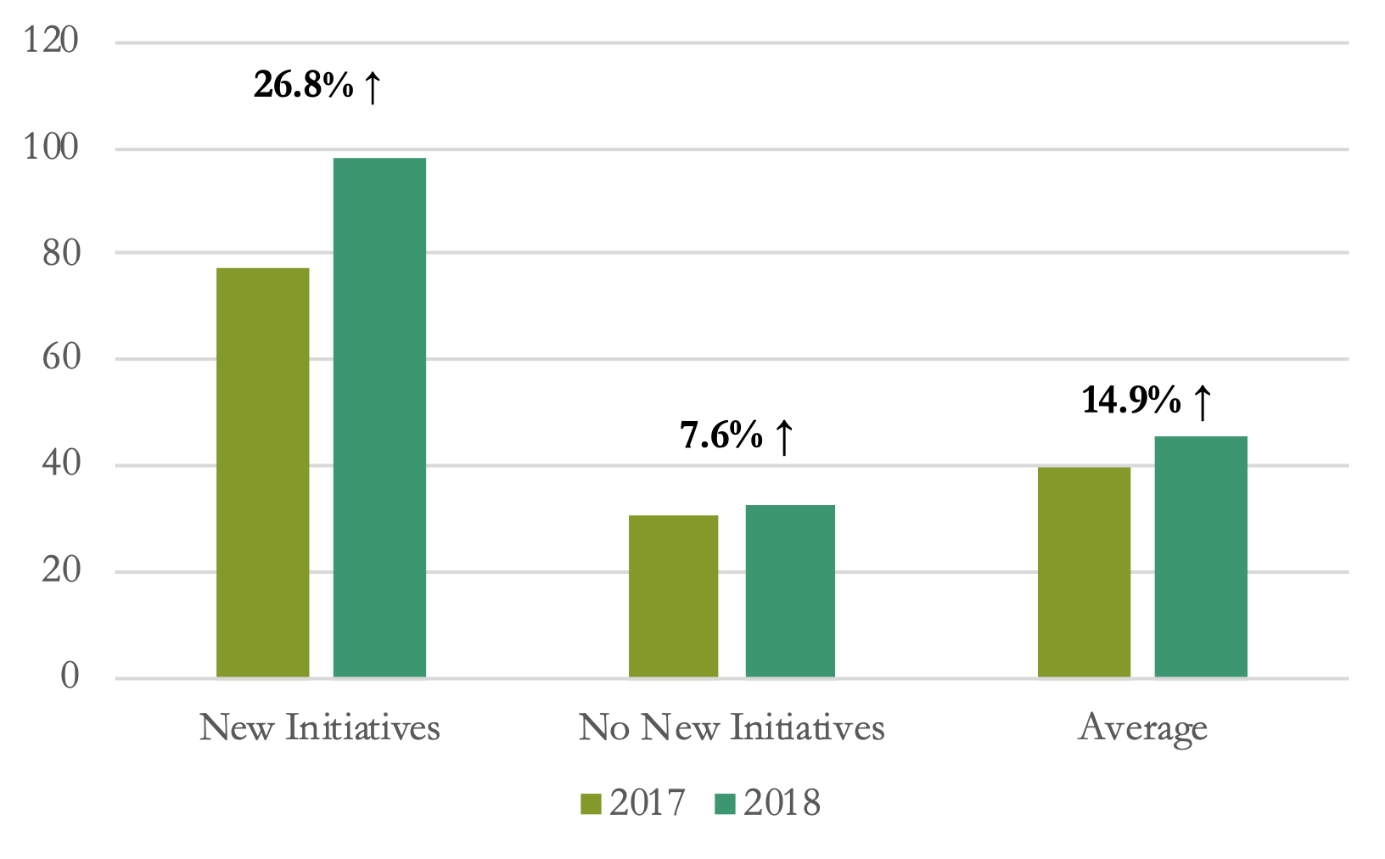
Effect of Initiatives to SAT Participation Rate

Slide 8
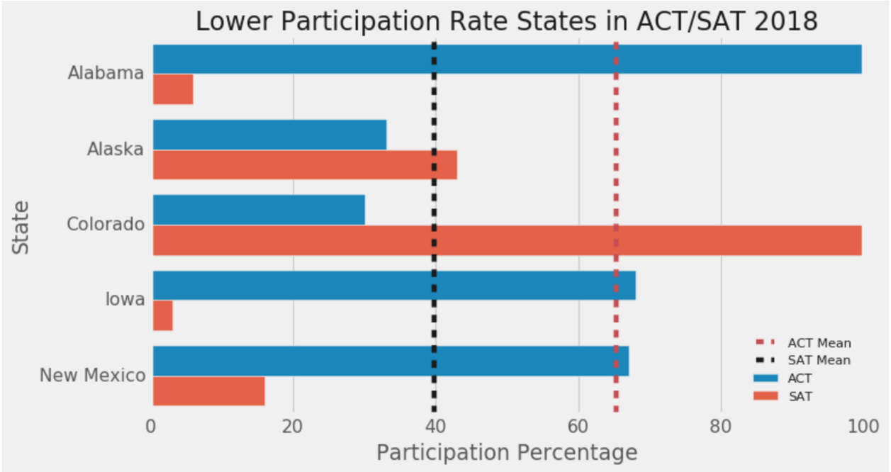
Recommendation
To provide fee wavier and SAT School Day to the lower participating states should be in the middle range of SAT and ACT
Alaska, Lowa, New Mexico

Slide 9
References:
•New initiative from SAT
•https://reports.collegeboard.org/archive/sat-suite-program-results/2017/class-2017-results
•SAT vs ACT
•https://blog.prepscholar.com/act-vs-sat

